Slide 1

Sentiment Analysis of Amazon Reviews
Jaydon Debus and Philipp Kouterguine

Slide 2
Motivation & Problem
Every day, millions of customers share their experiences through online reviews
For companies like Amazon, understanding customer sentiment at scale is critical for product improvement, brand monitoring, and competitive strategy
Manually reading and categorizing millions of reviews is impossible. businesses need automated, scalable solutions
Goal: Build a scalable, distributed sentiment analysis pipeline and validate its performance across increasing dataset sizes
Notes:
Explain why this problem matters. Online reviews are a key driver of consumer purchasing decisions, but manually analyzing millions of them is impractical. Frame the core challenge: how can we automatically classify customer sentiment — positive vs. negative — at scale? Highlight the volume of Amazon review data as both the opportunity and the engineering challenge. The dataset used contains millions of reviews across many product categories, making this a genuine big data problem rather than a toy example.

Slide 3
Background & Literature
Aravindan et al. (2023) confirmed that Logistic Regression with TF-IDF achieves over 87% accuracy on Amazon fine food review data using PySpark Mllib.
Bao (2024) demonstrated that rule-based models like VADER struggle with complex, longer review text. supports the use of a trained ML classifier
Olalekan (2025) confirms binary sentiment classification (Positive vs. Negative) remains the most widely validated and interpretable approach for e-commerce reviews
3-star reviews are consistently identified in the literature as mixed-sentiment signals that introduce label noise — justifying their exclusion from our dataset
Notes:
Walk through relevant prior work in sentiment analysis. Cover foundational NLP techniques — bag-of-words, TF-IDF representations, and classical classifiers like Logistic Regression and Naïve Bayes. Discuss why distributed frameworks like Apache Spark are necessary for processing data at this scale. Mention any key papers or benchmark datasets that informed the approach, such as the McAuley Amazon review corpus. Connect the literature to the design choices made in this project.

Slide 4
Project Setup
Cloud Infrastructure
Google Cloud Platform (GCP) Dataproc Cluster
Single-node instance — n1-standard-4, 15GB RAM
Apache Spark 3.5.3 | 8GB driver memory, 4GB executor memory
Cloud NAT Gateway for secure Hugging Face API access
Dataset
Amazon Reviews 2023 — Grocery & Gourmet Food
14.3 million total reviews, streamed via Hugging Face API
Subsets tested: 50,000 | 100,000 | 250,000 records
80% training / 20% validation split
Primary Model — Logistic Regression
HashingTF: 10,000 features
Max iterations: 10
Baseline Model — Naïve Bayes
Identical TF-IDF pipeline
Laplace smoothing: 1.0
Regularization: 0.01
Notes:
Describe the experimental setup. Explain the choice of Apache Spark MLlib for distributed text processing and classification. Outline the infrastructure: a single-node cluster running Spark in local mode. Three dataset sizes were tested — 50K, 100K, and 250K records — chosen to observe how performance and accuracy scale. Note that a 500K record run was attempted but failed due to memory exhaustion, which became one of the key findings. Mention the data source (Amazon product reviews) and any preprocessing steps done before ingestion into the pipeline.
HashingTF: 10,000 features TF stands for Term Frequency — it counts how often each word appears in a review. "Hashing" is the method used to convert words into numbers that the model can work with. The 10,000 means we're using 10,000 possible "slots" to store those word counts. Think of it like having 10,000 categories that every word in the vocabulary gets sorted into. More features = more detail, but also more memory. 10,000 is a standard, practical choice.
Max iterations: 10 Logistic Regression learns by repeatedly adjusting its internal weights to get better at predicting sentiment. Each adjustment is called an iteration. We capped it at 10, meaning the model gets 10 chances to improve itself before stopping. For a dataset this size with TF-IDF features, 10 iterations is generally sufficient to converge on a good solution without wasting computation time.
Regularization: 0.01 Regularization is a technique that prevents the model from "overfitting" — meaning memorizing the training data instead of learning general patterns. The value 0.01 controls how strongly that penalty is applied. A smaller value like 0.01 means light regularization, which makes sense here because our dataset is large enough that overfitting is less of a concern.
Laplace smoothing: 1.0 Naïve Bayes works by calculating probabilities for each word. The problem is if a word appears in the test set but never appeared during training, the model assigns it a probability of zero — which breaks the math entirely. Laplace smoothing fixes this by adding a small count of 1 to every word, even unseen ones, so no probability ever hits zero. A value of 1.0 is the standard default.
Naïve Bayes is a probability-based model. It looks at each word in a review independently and asks — given that this word appears, how likely is this review to be positive or negative? It then multiplies all those individual word probabilities together to make a final prediction. It's called "naïve" because it assumes every word is completely independent of every other word, which isn't really true in real language — but the simplification works surprisingly well in practice.
Logistic Regression is a classification algorithm that learns to draw a dividing line between two categories — in our case, Positive and Negative reviews.
During training, the model looks at thousands of reviews where it already knows the answer, and learns which words are most associated with positive sentiment and which are most associated with negative sentiment. Words like "amazing" or "delicious" get pushed toward positive, words like "terrible" or "disgusting" get pushed toward negative.
Once trained, when it sees a new review it has never seen before, it calculates a probability score between 0 and 1. If the score is above 0.5, it predicts Positive. Below 0.5, it predicts Negative. That probability score is also what we show as the confidence percentage in our interactive demo.
The reason we chose Logistic Regression over something more complex like a neural network is exactly what the literature supports — for large datasets with TF-IDF features, it is fast, interpretable, scalable, and consistently delivers strong accuracy without the computational overhead of deep learning models.

Slide 5
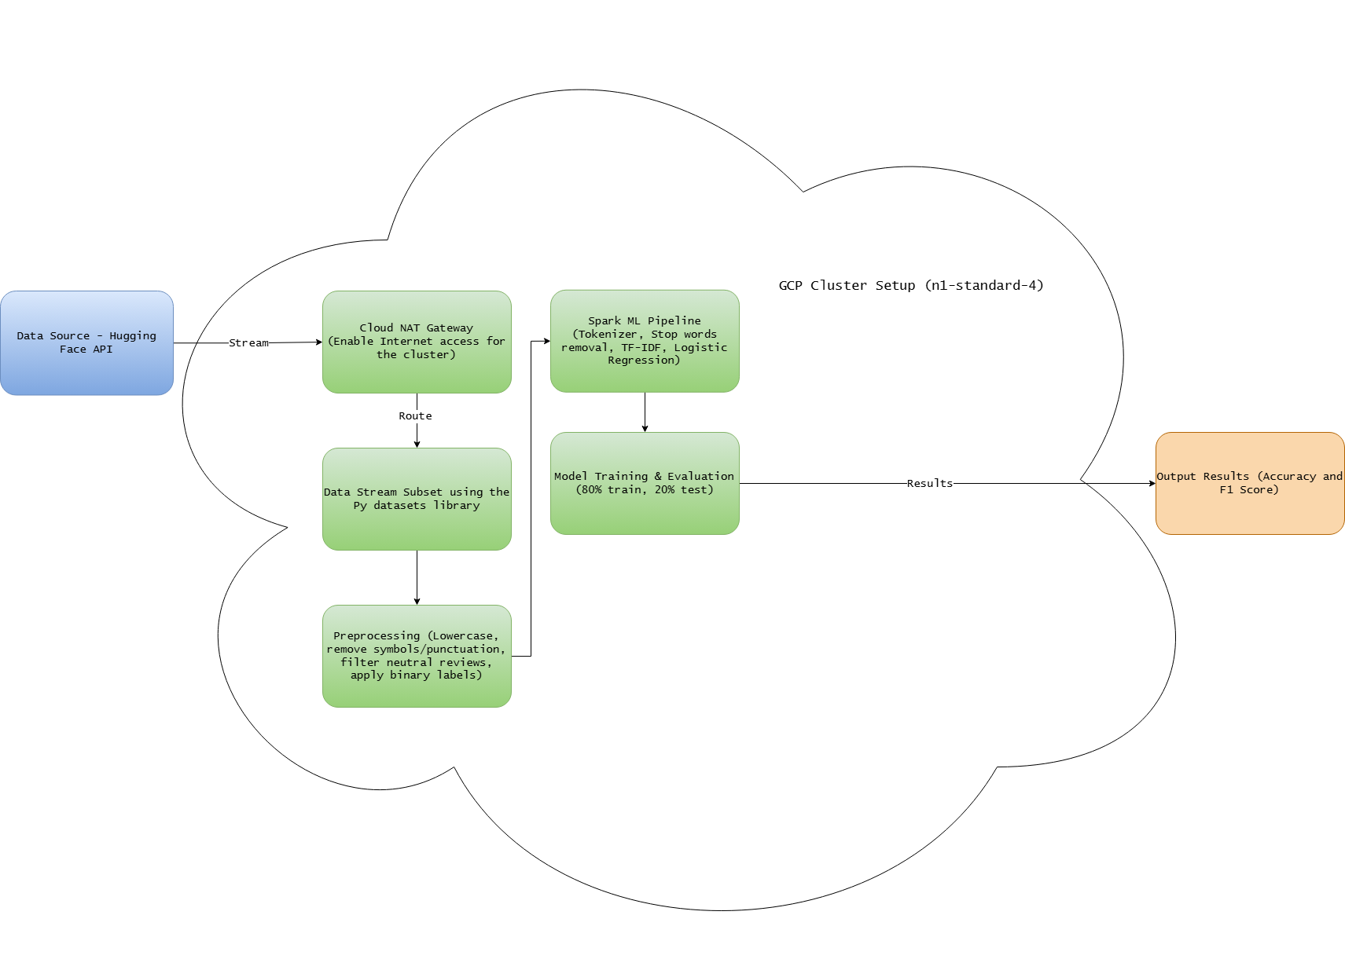
System Architecture
Notes:
Walk through the system architecture diagram. The end-to-end pipeline flows from raw Amazon review ingestion through text preprocessing, feature engineering with TF-IDF, model training, and final sentiment prediction output. Emphasize that all stages run within Spark's distributed execution model, meaning the same code can scale from a single node to a multi-node cluster with minimal changes. Point out how the modular design makes it easy to swap in alternative models or feature extraction methods in future iterations.

Slide 6

Distributed ML Pipeline
Stage | Component | Purpose
1 | Tokenizer | Split review text into individual words
2 | StopWordsRemover | Filter uninformative common words
3 | HashingTF | Convert words to numerical feature vectors
4 | IDF | Weight terms by importance across corpus
5 | Logistic Regression | Binary sentiment classification
Notes:
Walk through each of the five pipeline stages: (1) Tokenizer — splits raw review text into individual words/tokens; (2) StopWordsRemover — filters out common but uninformative words like 'the', 'is', 'a' that add noise without predictive value; (3) HashingTF — converts the cleaned token list into a fixed-size numerical feature vector using the hashing trick, avoiding the need for a vocabulary dictionary; (4) IDF (Inverse Document Frequency) — rescales the TF features by downweighting terms that appear frequently across the entire corpus, lifting the signal from rarer, more discriminating words; (5) Logistic Regression — trains a binary classifier to predict positive or negative sentiment. Emphasize that this entire sequence is wrapped in a single Spark Pipeline object, making it trivial to call fit() and transform() in one step, and ensuring the same preprocessing steps are applied identically at training and inference time.

Slide 7
Class distribution & training/validation
Class Distribution
Training / Validation Split
Dataset Size | Positive | Negative
50,000 | 40,070 | 5,987
100,000 | 81,542 | 10,839
250,000 | 205,385 | 26,436
Dataset Size | Training Set | Validation Set
50,000 | 37,001 | 9,056
100,000 | 73,977 | 18,404
250,000 | 185,440 | 46,381
Key Findings
✓ Significant class imbalance across all dataset sizes (~87% positive vs ~13% negative) ✓ 80/20 training-validation split maintained consistently across all dataset sizes ✓ Largest dataset (250K) provides 185,440 training samples for robust model fitting
Notes:
Draw the audience's attention to the significant class imbalance: across all three dataset sizes, approximately 87% of reviews are positive and only 13% are negative. This mirrors the real-world distribution of Amazon reviews, where customers tend to leave reviews when satisfied. Discuss the implications: the model can achieve ~87% accuracy simply by predicting 'positive' every time — so the F1-score and per-class metrics matter more than raw accuracy here. On the training split: an 80/20 split was applied consistently across all sizes. The 250K dataset yields 185,440 training examples, providing substantially more signal for the model. Note that the 50K dataset (37,001 training samples) still performs well, suggesting TF-IDF + Logistic Regression is relatively data-efficient.

Slide 8
Logistic Regression vs. Naïve Bayes
Logistic Regression
Naïve Bayes
Dataset Size | Training Time | Accuracy | F1-Score
50,000 | 18.71s | 91.43% | 90.78%
100,000 | 17.00s | 92.07% | 91.29%
250,000 | 31.54s | 92.82% | 92.04%
Dataset Size | Training Time | Accuracy | F1-Score
50,000 | 10.05s | 87.90% | 88.72%
100,000 | 14.69s | 87.93% | 88.94%
250,000 | 31.81s | 89.24% | 90.07%
Key Findings
✓ Logistic Regression outperforms Naïve Bayes by +3.58% accuracy at 250K records ✓ Naïve Bayes trains faster at smaller datasets (10.05s vs 18.71s at 50K) ✓ Both models converge in training time at 250K records (~31s)
Notes:
Compare the two models head-to-head. Key takeaways: Logistic Regression consistently outperforms Naive Bayes in accuracy across all dataset sizes — at 250K records, LR achieves 92.82% vs NB's 89.24%, a 3.58 percentage point gap. LR's F1-score (92.04%) also beats NB (90.07%), meaning LR handles the class imbalance better. On training time: Naive Bayes is faster at smaller scales (10.05s vs 18.71s at 50K), which may favor NB in latency-sensitive or resource-constrained scenarios. However, both models converge to nearly identical training times at 250K records (~31s), eliminating NB's speed advantage at scale. Potential audience questions: Why not try more complex models like SVM or neural networks? (Answer: complexity vs. interpretability tradeoff, and Spark MLlib's well-optimized LR implementation already achieves strong results.) How would results differ with better handling of class imbalance, e.g. oversampling or class weights?

Slide 9
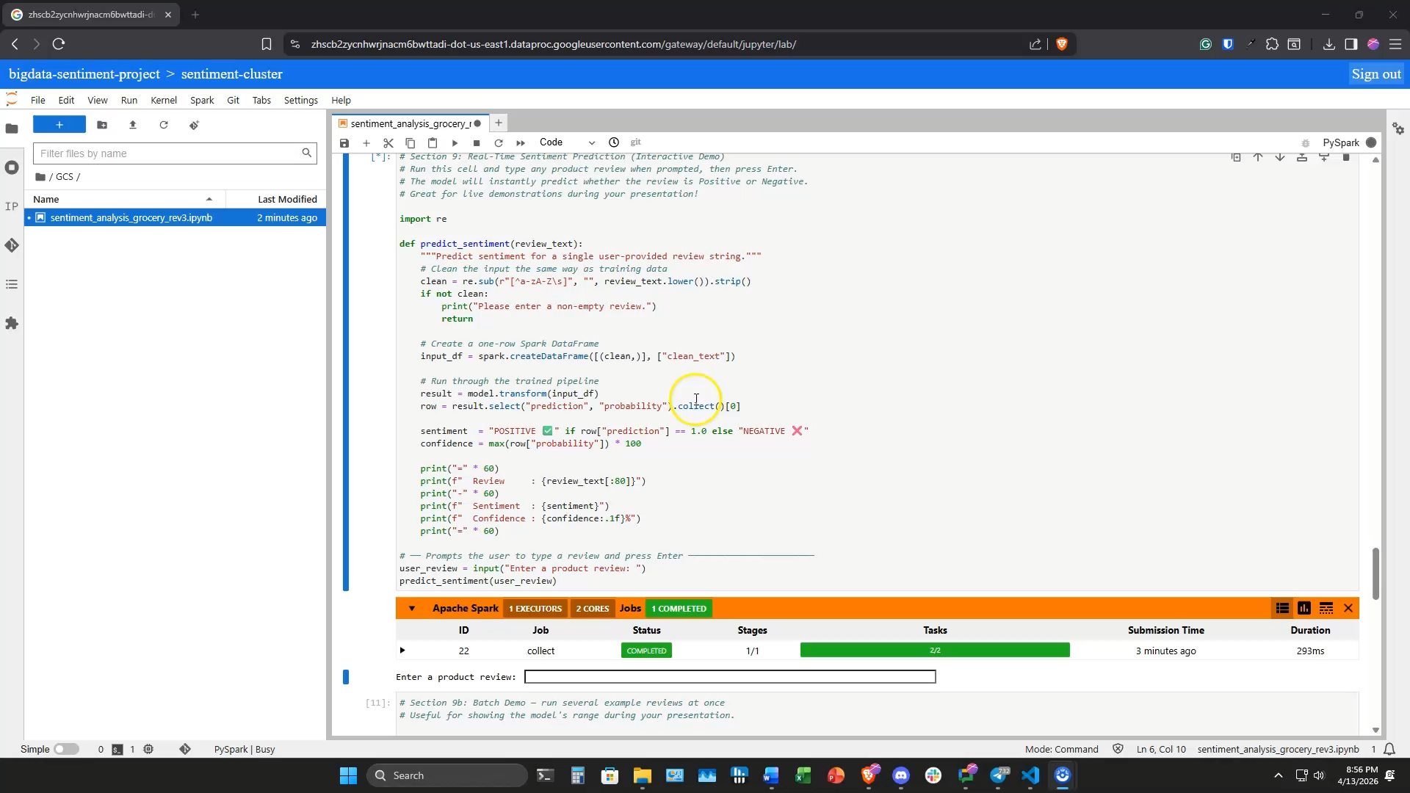
Demonstration

Slide 10
Discussion
Accuracy increases with scale: Consistent gains from 91.43% to 92.82% as dataset size increases from 50k to 250k records, validating the big data approach
JVM warm-up effect: the 100k run completed faster than the 50k run (17.00s vs. 18.71s) due to Spark's JVM initialization overhead on first execution
Class imbalance: ~87–88% of reviews are positive across all dataset sizes; despite this, the model correctly classified the vast majority of reviews in manual testing
Infrastructure ceiling: the 500,000 record run crashed due to memory exhaustion on the single-node cluster, demonstrating the real-world need for multi-node distributed infrastructure at full scale
Notes:
Discuss the four key findings in depth. (1) Accuracy scales with data: LR accuracy rises consistently from 91.43% at 50K to 92.82% at 250K — each doubling of data yields measurable gains, validating the core hypothesis that more data improves the model. (2) JVM warm-up effect: the 100K run (17.00s) was actually faster than the 50K run (18.71s). This counterintuitive result is explained by Spark's JVM initialization overhead on the first execution — subsequent runs benefit from a warmed-up JVM. This is important context when benchmarking distributed systems. (3) Class imbalance: ~87-88% of all reviews are positive across every dataset size. Despite this skew, the model performs well in manual testing, though precision/recall on the negative class deserves closer scrutiny in future work. (4) Infrastructure ceiling: the 500K record run crashed due to memory exhaustion on the single-node cluster. This is not a failure — it's a concrete demonstration of why multi-node distributed infrastructure is necessary at production scale. It also validates the entire motivation for using Spark in the first place.

Slide 11

Future Work
Scale to a multi-node GCP Dataproc cluster to process the full 14.3 million review dataset
Incorporate per-class precision and recall metrics to better account for class imbalance
Explore word embeddings (Word2Vec, GloVe) as an alternative to TF-IDF for richer semantic representation
Expand analysis to additional Amazon product categories to test generalizability
Investigate 32GB RAM single-node configuration as an intermediate scaling step before full multi-node deployment
Notes:
Lay out the five directions for future work and why each matters. (1) Multi-node GCP Dataproc cluster: the 500K crash demonstrated this is necessary to unlock the full 14.3 million review dataset — a cluster of even 3-4 nodes would resolve the memory bottleneck. (2) Per-class precision and recall: with 87% positive class dominance, overall accuracy is a misleading metric. Per-class F1 for the negative class would reveal how well the model actually catches negative reviews. (3) Word embeddings (Word2Vec, GloVe): TF-IDF treats words as independent features and misses semantic relationships. Embeddings would capture context — e.g., 'not good' vs 'good' would be represented differently. (4) Additional product categories: the current dataset may be from a single category; testing on diverse categories (electronics, clothing, food) would validate generalizability. (5) 32GB RAM single-node: a lower-cost intermediate step — upgrading RAM on the existing machine may extend the viable dataset size before requiring a full multi-node deployment.

Slide 12
Questions?
Notes:
Open the floor for Q&A. Be ready to address likely questions: (1) Why Logistic Regression over more complex models? — LR is highly interpretable, trains efficiently in Spark MLlib, and already achieves strong accuracy; complexity would add cost without clear benefit at this stage. (2) How was class imbalance handled? — It wasn't explicitly addressed in this iteration; future work will add class weights and per-class metrics. (3) What would it take to scale to the full 14.3M review dataset? — A multi-node GCP Dataproc cluster with sufficient RAM, plus potential partitioning strategy changes. (4) How would the model perform on non-Amazon data? — Unknown without testing; generalizability is a key open question. (5) Could this work in real-time? — Yes, with Spark Streaming; the pipeline model is already serializable for inference. Thank the audience and close.

